Slide 1

LANGUAGE TRANSLATOR : Personal Language
Narola Devanshi IT-055
Otha Adil D. IT-056

Slide 2
Description
A language designed specifically for alphanumeric String related Operations with built-in operators for quick and easy conversions as per the user’s requirement.

Slide 3
Features
Store Strings in user defined variables of type $[a-z]
Recognize whether String is an email
Insert String in a given String at specified position
Read and Write Strings from/to a specified file
Check whether Substring exists in a specified String
Inversion of Case (upper/lower)
Different types of Concatenation

Slide 4
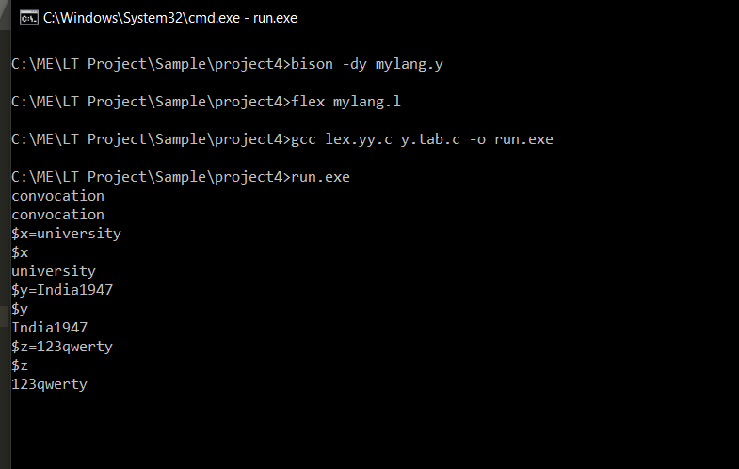
Examples
Echoing Strings and Storing them in variables:

Slide 5
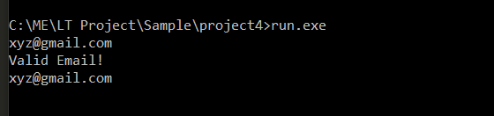
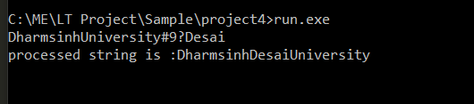
Examples
Recognize Emails
Insert String at specified position

Slide 6
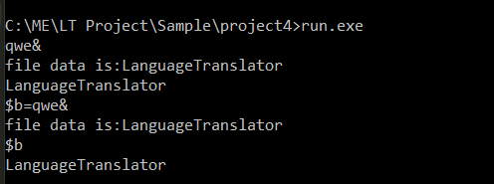
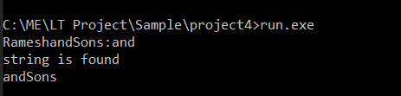
Examples
Read String from specified file named qwe.txt
Check existence of Substring

Slide 7
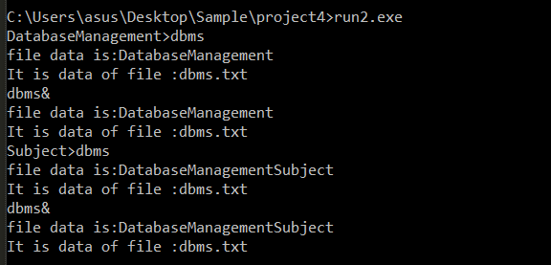
Examples
File Read and Write Operations

Slide 8

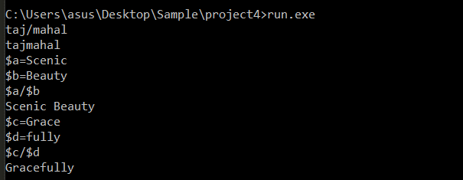
Examples
Inversion of Case
Concatenation

